Slide 1
Introduction to Object Oriented Programming
Dept. of Computer Science & Engineering

Slide 2
Computer Programming
A computer program is a step-by-step set of instructions for a computer
Programming Language allow programmers to write a program that can perform a specific task
With time and progress in technology, writing a program became much easier
A low level language are often described as machine oriented languages that closer to the hardware
High-level languages represent a giant leap towards easier programming
There are five generations of programming language

Slide 3
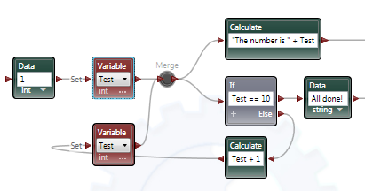
Generation of Programming Language
Generation | Explanation | Example of Code
1st generation (Machine Language) | Uses a series of binary digits (1s and 0s) | 10001110
2nd generation (Assembly Language) | Programmer writes instructions using symbolic instruction codes that are meaningful abbreviations | ADD 1001, 1100
3rd generation (Procedural Language) | Make complex programming simpler and easier to read, write and maintain | int x=10+5;
4th generation (Non-procedural Language) | Enables users to access data in a database | SELECT id FROM student
5th generation (Visual or Natural Language) | Provides a visual or graphical interface, called a visual programming environment, for creating source codes
1st and 2nd generation are considered as low-level language and the rest are considered as high-level language

Slide 4
Programming Approaches
Since the invention of the computer, many programming approaches have been tried.
Structured Programming
Modular Programming
Object Oriented Programming
Top-down & Bottom-up Programming
The primary motivation in each case has been the concern to handle the increasing complexity of programs

Slide 5
Structured Programming
Consists of writing a list of instructions for the computer to follow and organize these instructions into groups known as functions
It also supports modular programming and follows top-down approach
Usually functions share global data
Global data are more vulnerable to change by a function
In a large program it becomes difficult to identify which data is used by which function
Can not model real-world problems very easily

Slide 6
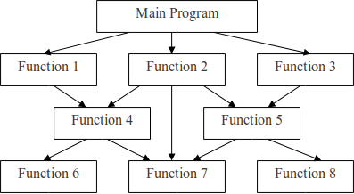
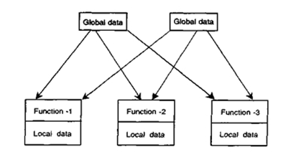
Structured Programming (Contd.)
Fig. Organizations of data and functions in structured programming

Slide 7
Object Oriented Programming
Object oriented programming is a programming approach that relies on the concept of classes and objects
It removes some of the flaws encountered in the procedural approach of programming
OOP treats data as a critical element and does not allow data to flow freely around the system
Programs are divided into objects where the data and functions are built around these objects
Objects may communicate with each other via functions
New data and functions can be added whenever necessary

Slide 8
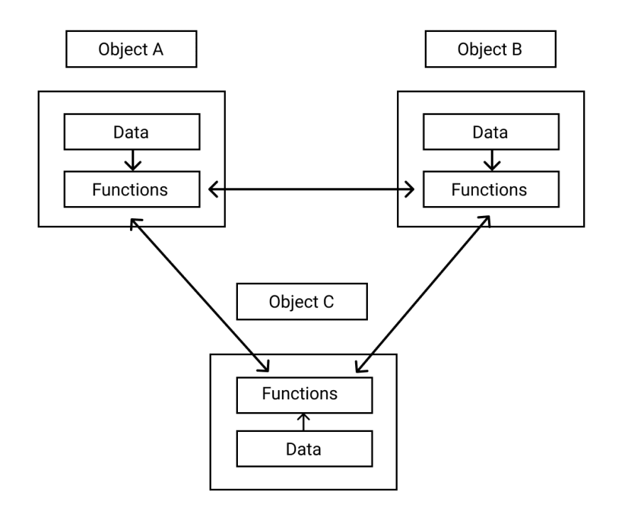
Object Oriented Programming (Contd.)
Fig. Organizations of data and functions in OOP

Slide 9
Structured vs Objected-oriented Programming
Structured Programming | Objected Oriented Programming
i) Program is divided into a number of sub-modules or functions | i) Program is organized by having a number of classes and objects
ii) It follows top-down approach | ii) It follows bottom-up approach
iii) No encapsulation. Data and functions are separate | iii) Allow encapsulation. Data and functions are put together
iv) Software reuse is not possible | iv) Software reuse is possible
v) Example: ALGOL, PASCAL, C | v) Example: Java, Python, C++

Slide 10

OOP Basic Concepts
Object: Represents entity in an object-oriented system. It can be person, place, bank account or a table of data etc.
Object is anything to which you can apply a concept
Object contains data and methods
Student
Car
Bank account
Fig: Example of objects

Slide 11
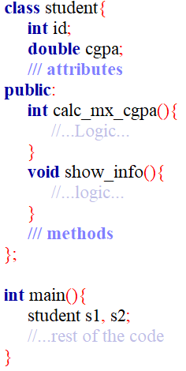
OOP Basic Concepts (Contd.)
Class: A category of similar objects
Class act as a blueprint for creating object
Class consists of three things: class name, attributes and methods
Attributes are properties of an object
Methods represents actions performed by the object
In the code, student is the class name
In the main function,
two objects s1 and s2 have been created

Slide 12
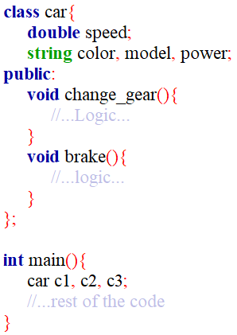
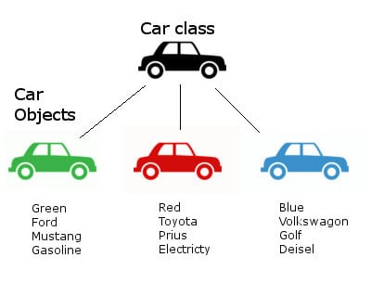
OOP Basic Concepts (Contd.)
Another example of class: A vehicle class containing some attributes and methods
C1
C2
C3
Each copy of an object from a particular class is called an instance of the class.

Slide 13
Class vs Object
Class | Object
i) Class is a data type | i) Object is an instance of Class
ii) It generates OBJECTS | ii) It gives life to CLASS
iii) Does not occupy memory location | iii) It occupies memory location
iv) It cannot be manipulated because it is not available in memory | iv) It can be manipulated during runtime

Slide 14
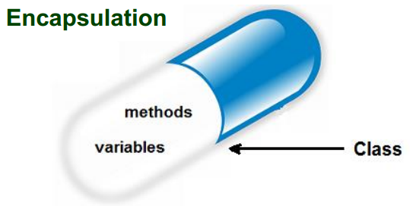
Basic Features of a Class
All OOP languages, including C++, share three common features
Encapsulation
Polymorphism
Inheritance
Encapsulation: It is the mechanism that binds together code and the data it manipulates, and keeps both safe from outside interference and misuse
It wraps data and functions into a single unit

Slide 15
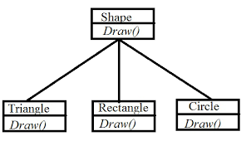
Basic Features of a Class (Contd.)
Polymorphism: Polymorphism is the quality that allows one name to be used for two or more related but technically different purposes
Polymorphism means “many forms”
In C, to find the absolute value of integer, long and float data types we need to use abs(), labs() and fabs() function name
But in C++, we can do these for all three data types using abs() function name
Here, depending on the parameter it will draw the shape
Fig: Drawing a shape using same function name

Slide 16
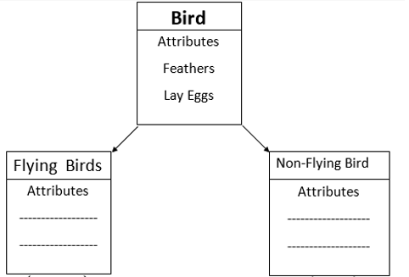
Basic Features of a Class (Contd.)
Inheritance: Inheritance is the process by which one object can acquire the properties of another
An object can inherit a general set of properties from a class and can also add extra features that are specific only to itself
Both flying and non-flying birds have some common properties, but they also have some distinguishing properties

Slide 17
Benefits of Using OOP
OOP allows multiple instances of an object to co-exist without any interference
Encapsulation ensures that the data is protected from outside function blocks
Through inheritance, we can eliminate redundant code
OOP systems can be easily upgraded from small to large systems
Software complexity can be easily managed
Main advantage is that, you can create an object which represents some real one, put the logic inside it and hide all the implementation details behind some interface

Slide 18
Thank You

